Slide 1




MENTORESS
YOUTUBE SONG ANALYSIS
WITH POWER BI

Slide 2


PROBLEM STATEMENT
This project aims to conduct a comprehensive analysis of YouTube songs data using Power BI.
The dataset contains key attributes such as video ID, channel title, title, description, tags, published date,
view count, like count, favorite count, comment count, video duration, video definition, and caption
details. The goal is to utilize Power BI to create insightful visualizations and reports that provide a deeper
understanding of YouTube songs' performance, popularity, and user engagement. The analysis aims to
uncover trends, preferences, and patterns in the data to aid content creators and stakeholders in
optimizing their YouTube song content.

Slide 3


PROJECT OBJECTIVES
1. Data Cleaning and Preparation:
- Clean and preprocess the dataset, handling missing values or outliers.
- Convert relevant columns to appropriate data types.
2. Exploratory Data Analysis (EDA):
- Explore patterns and distributions in view counts, like counts, and comments.
- Identify trends in the popularity and engagement of YouTube song videos.
3. Content and Channel Analysis:
- Analyze the distribution of videos across different channels
- Identify popular tags and their correlation with view counts..
4. Temporal Trends:
- Explore how YouTube song video metrics vary over time.
- Identify peak publishing times and their impact on engagement.
5. User Engagement Insights:
- Investigate relationships between likes, comments, and views.
- Identify factors influencing user engagement with YouTube song videos.

Slide 4


DATASET DESCRIPTION
1. video_id: Unique identifier for each YouTube video.
2. channelTitle: Title of the YouTube channel publishing the song.
3. title: Title of the YouTube song video.
4. description: Description provided for the YouTube song video.
5. tags: Tags associated with the YouTube song video.
6. publishedAt: Date and time when the YouTube song video was published.
7. viewCount: Number of views received by the YouTube song video.
8. likeCount: Number of likes received by the YouTube song video.
9. favoriteCount: Number of times the YouTube song video has been marked as a favorite.
10. commentCount: Number of comments posted on the YouTube song video.
11. duration: Duration of the YouTube song video.
12. definition: Video definition or quality (e.g., HD, SD).
13. caption: Availability of captions for the YouTube song video.

Slide 5


1. Data Cleaning and Preparation:
Data Cleaning - Droping columns such as video ID and favourite count
Favourite count column was dropped because the rows contained in all of them

Slide 6
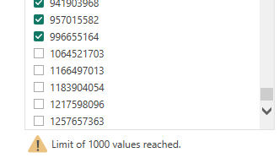
OUtliers
Dealing with outliers involved deselecting values from the columns after arranging in either ascending or descending order

Slide 7
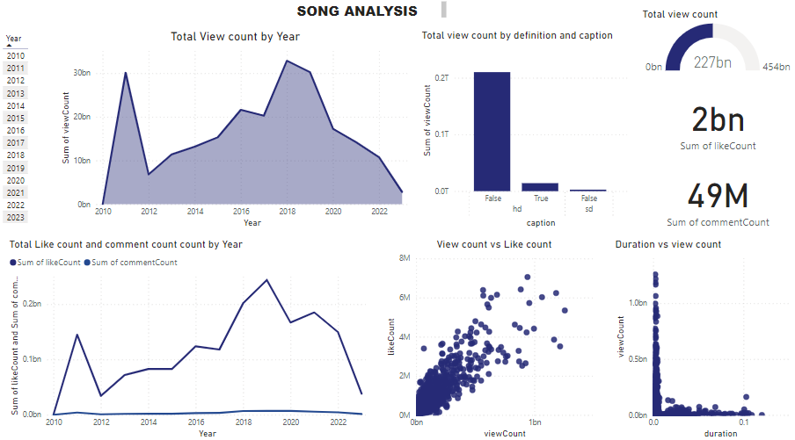
POWER BI DASHBOARD

Slide 8
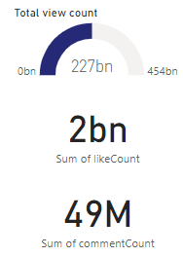
DASHBOARD ANALYSIS
Total view count from 2010 to 2023 equalled 227 billion views while the total sum count was 2 billion likes and comment count was at 49 billion

Slide 9
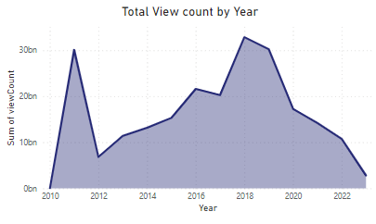
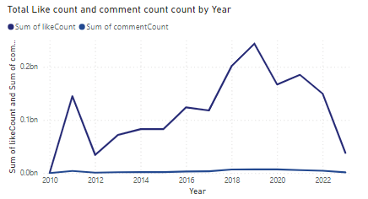
DASHBOARD ANALYSIS
The view count of songs based on the years shows varying trends with the highest view count being between 2018 and 2019 and the lowest view count being in 2010
The lke count of songs based on the years shows varying trends and is almost similar trend to the view count . There is a continous rise between 2012 and 2018

Slide 10
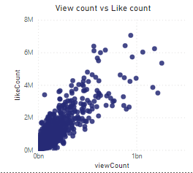
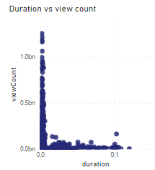
Like count vs view count analysis
The distribution of view count vs like count shows a linear distribution such that as the number of views increases the like count also increases
From the above visualization it shows that most view counts are for songs that are of short durations. As the durations increases the view count decreases

Slide 11
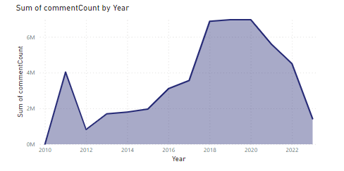
DASHBOARD ANALYSIS
The comment count has shown an increase from 2012 and remains almost constant between 2016 to 2020 but with a little increase then gegins to decrease from 2020

Slide 12
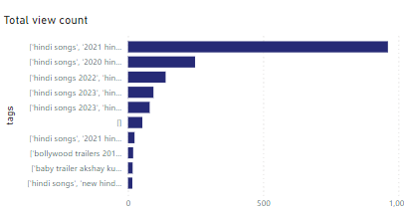
DASHBOARD ANALYSIS
Songs with the tag of hind songs new song, bollywood song and t-series had the highest view count

Slide 13
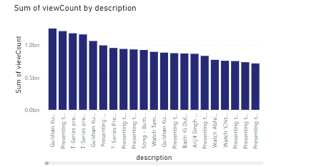
DASHBOARD ANALYSIS
Songs with the description of the song and had listed all the music platforms the song was shared to had the highest number of views

Slide 14
Conclusions
Total Metrics Overview (2010-2023):
Total Views: 227 billion
Total Likes: 2 billion
Total Comments: 49 billion
Trends Over Time:
Views: Highest between 2018 and 2019, lowest in 2010. This indicates a significant growth in YouTube's popularity and song content consumption over the years.
Likes: Similar trend to views with a continuous rise between 2012 and 2018. This suggests that user engagement through likes grew alongside views.
Comments: Increase from 2012, almost constant from 2016 to 2020, with a slight increase and then a decrease from 2020. This might reflect changing user behavior or engagement strategies.
View Count vs. Like Count:
There is a linear distribution showing that as the number of views increases, the like count also increases. This correlation indicates that popular videos tend to receive more likes.
Content Duration:
Most view counts are for songs of shorter durations. As the duration increases, the view count decreases. This suggests that shorter videos are more popular and likely to be watched more frequently.
Tag and Description Impact:
Songs tagged with "hind songs new song," "bollywood song," and "t-series" had the highest view count. This indicates a strong audience preference for Bollywood and T-Series content.
Songs with detailed descriptions, including music platform listings, had higher views. This suggests that comprehensive information and cross-platform promotion enhance viewership.

Slide 15
RECOMMENDATIONS
Optimize Video Length:
Focus on creating shorter song videos to maximize view counts, as shorter durations tend to attract more viewers.
Enhance Tags and Descriptions:
Use popular and relevant tags like "hind songs new song," "bollywood song," and "t-series" to reach a wider audience.
Include detailed descriptions that list all music platforms where the song is available to increase visibility and engagement.
Engage with Viewers:
Encourage viewers to like and comment on videos to boost engagement metrics, which are correlated with higher view counts.
Monitor Trends:
Keep track of viewing trends to understand peak periods of user engagement and tailor content releases accordingly, focusing on maintaining high activity around years similar to 2018-2019.
Leverage Cross-Platform Promotion:
Promote songs across various platforms and include this information in the video descriptions to enhance discoverability and drive more views.
Maintain Consistent Quality:
Focus on the consistent quality of content to retain audience interest and encourage repeated views, likes, and comments.
Analyze Competitor Strategies:
Study successful videos and channels (especially T-Series) to understand what drives their high view counts and adapt similar strategies for your content.
Adapt to Audience Preferences:
Continuously analyze audience preferences and feedback to create content that resonates well with viewers, ensuring relevance and high engagement.

Slide 16

THANK YOU

